Slide 1

Optimizing Property Investment Allocation.
BY: MELISSA HAWKINS
Notes:
Hi my name is Melissa Hawkins and I want to welcome you to my presentation on optimizing property investment allocation using statistical analysis. We’ll explore how statistical analysis can be a valuable tool in making informed decisions and maximizing returns in the realm of property investment

Slide 2


How we should allocate reserved dollars for investment into mortgage-backed securities using statistical analysis
What is helpful information to evaluate before investing?
How can we determine what the best factors that will maximize returns while managing risk?
Notes:
This project is about analyzing the housing market in Ames Iowa. We will explore the key factors affecting property values, such as location, quality, and neighborhood characteristics. We’ll discuss how these conforms investment decisions and marketing strategies

Slide 3

Ames, Iowa Housing Dataset ‘15
100k
TOTAL RECORDS
25
UNIQUE NEIGHBORHOODS
1,460
RESIDENTAL HOMES
Widely recognize far is high quality and accuracy, the Ames, Iowa housing dataset includes a wide range of variables making it the ideal choice when predicting housing prices, understanding market trends and exploring the impact of different factors on property values.
80
DETAILED VARIABLES ON SIZE, AGE, LOCATION, AND FEATURES

Slide 4
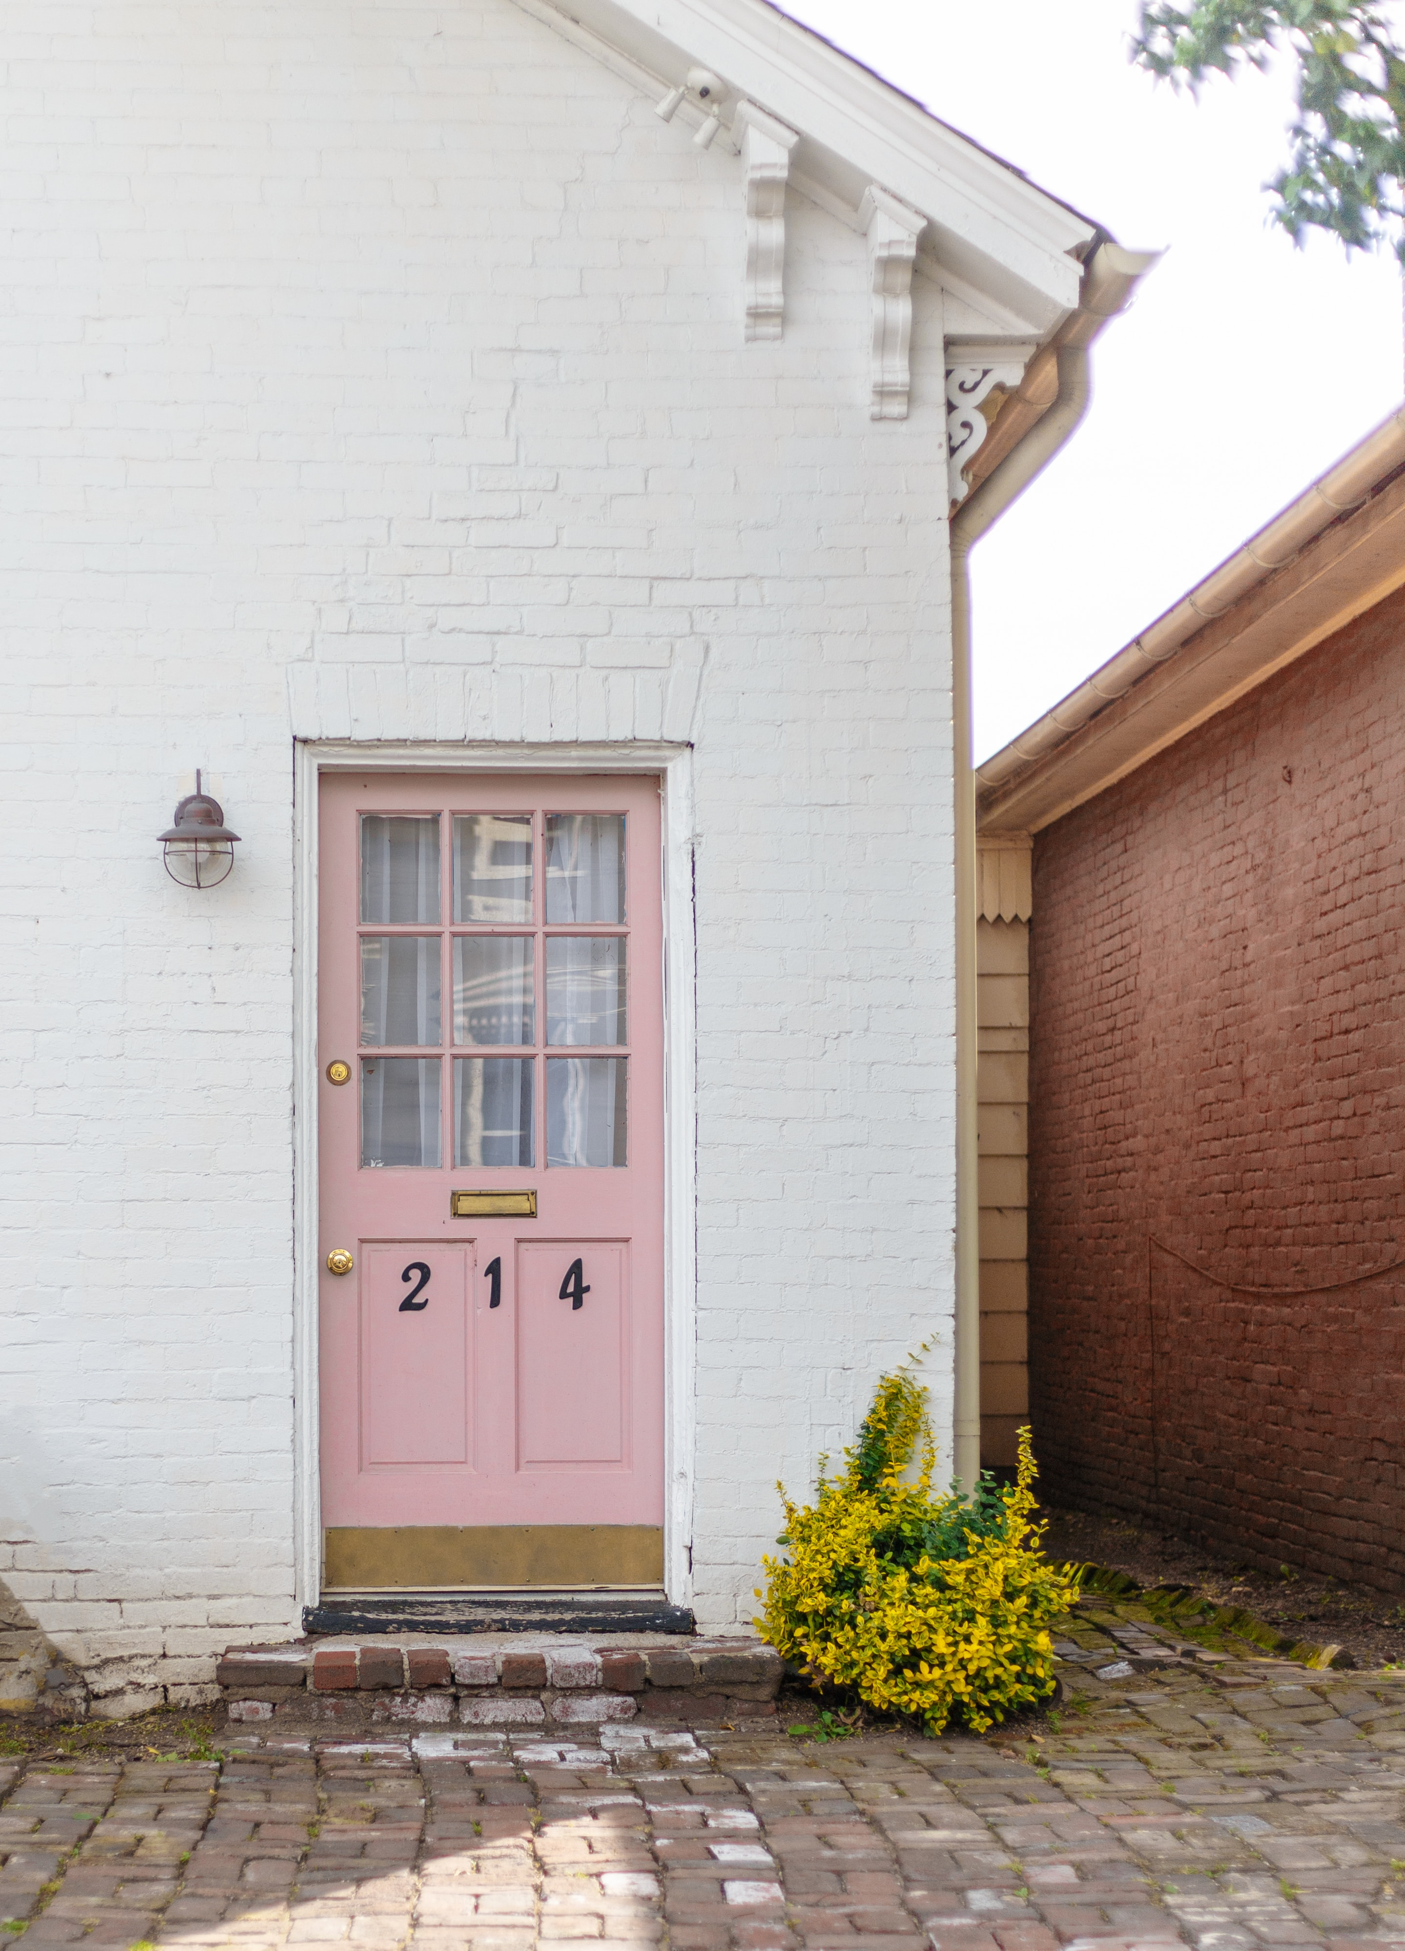
Hypotheses.
Is there a significant difference in investing in above average quality homes compared to below average quality homes?
01
Is there a significant difference in investing in top neighborhoods compared to other neighborhoods?
02
Is there a significant difference in investing in one story homes compared to two-story homes?
03
Notes:
As I devled into the data, patterns and insight started to emerge, leading me to develop my own hypothesis

Slide 5

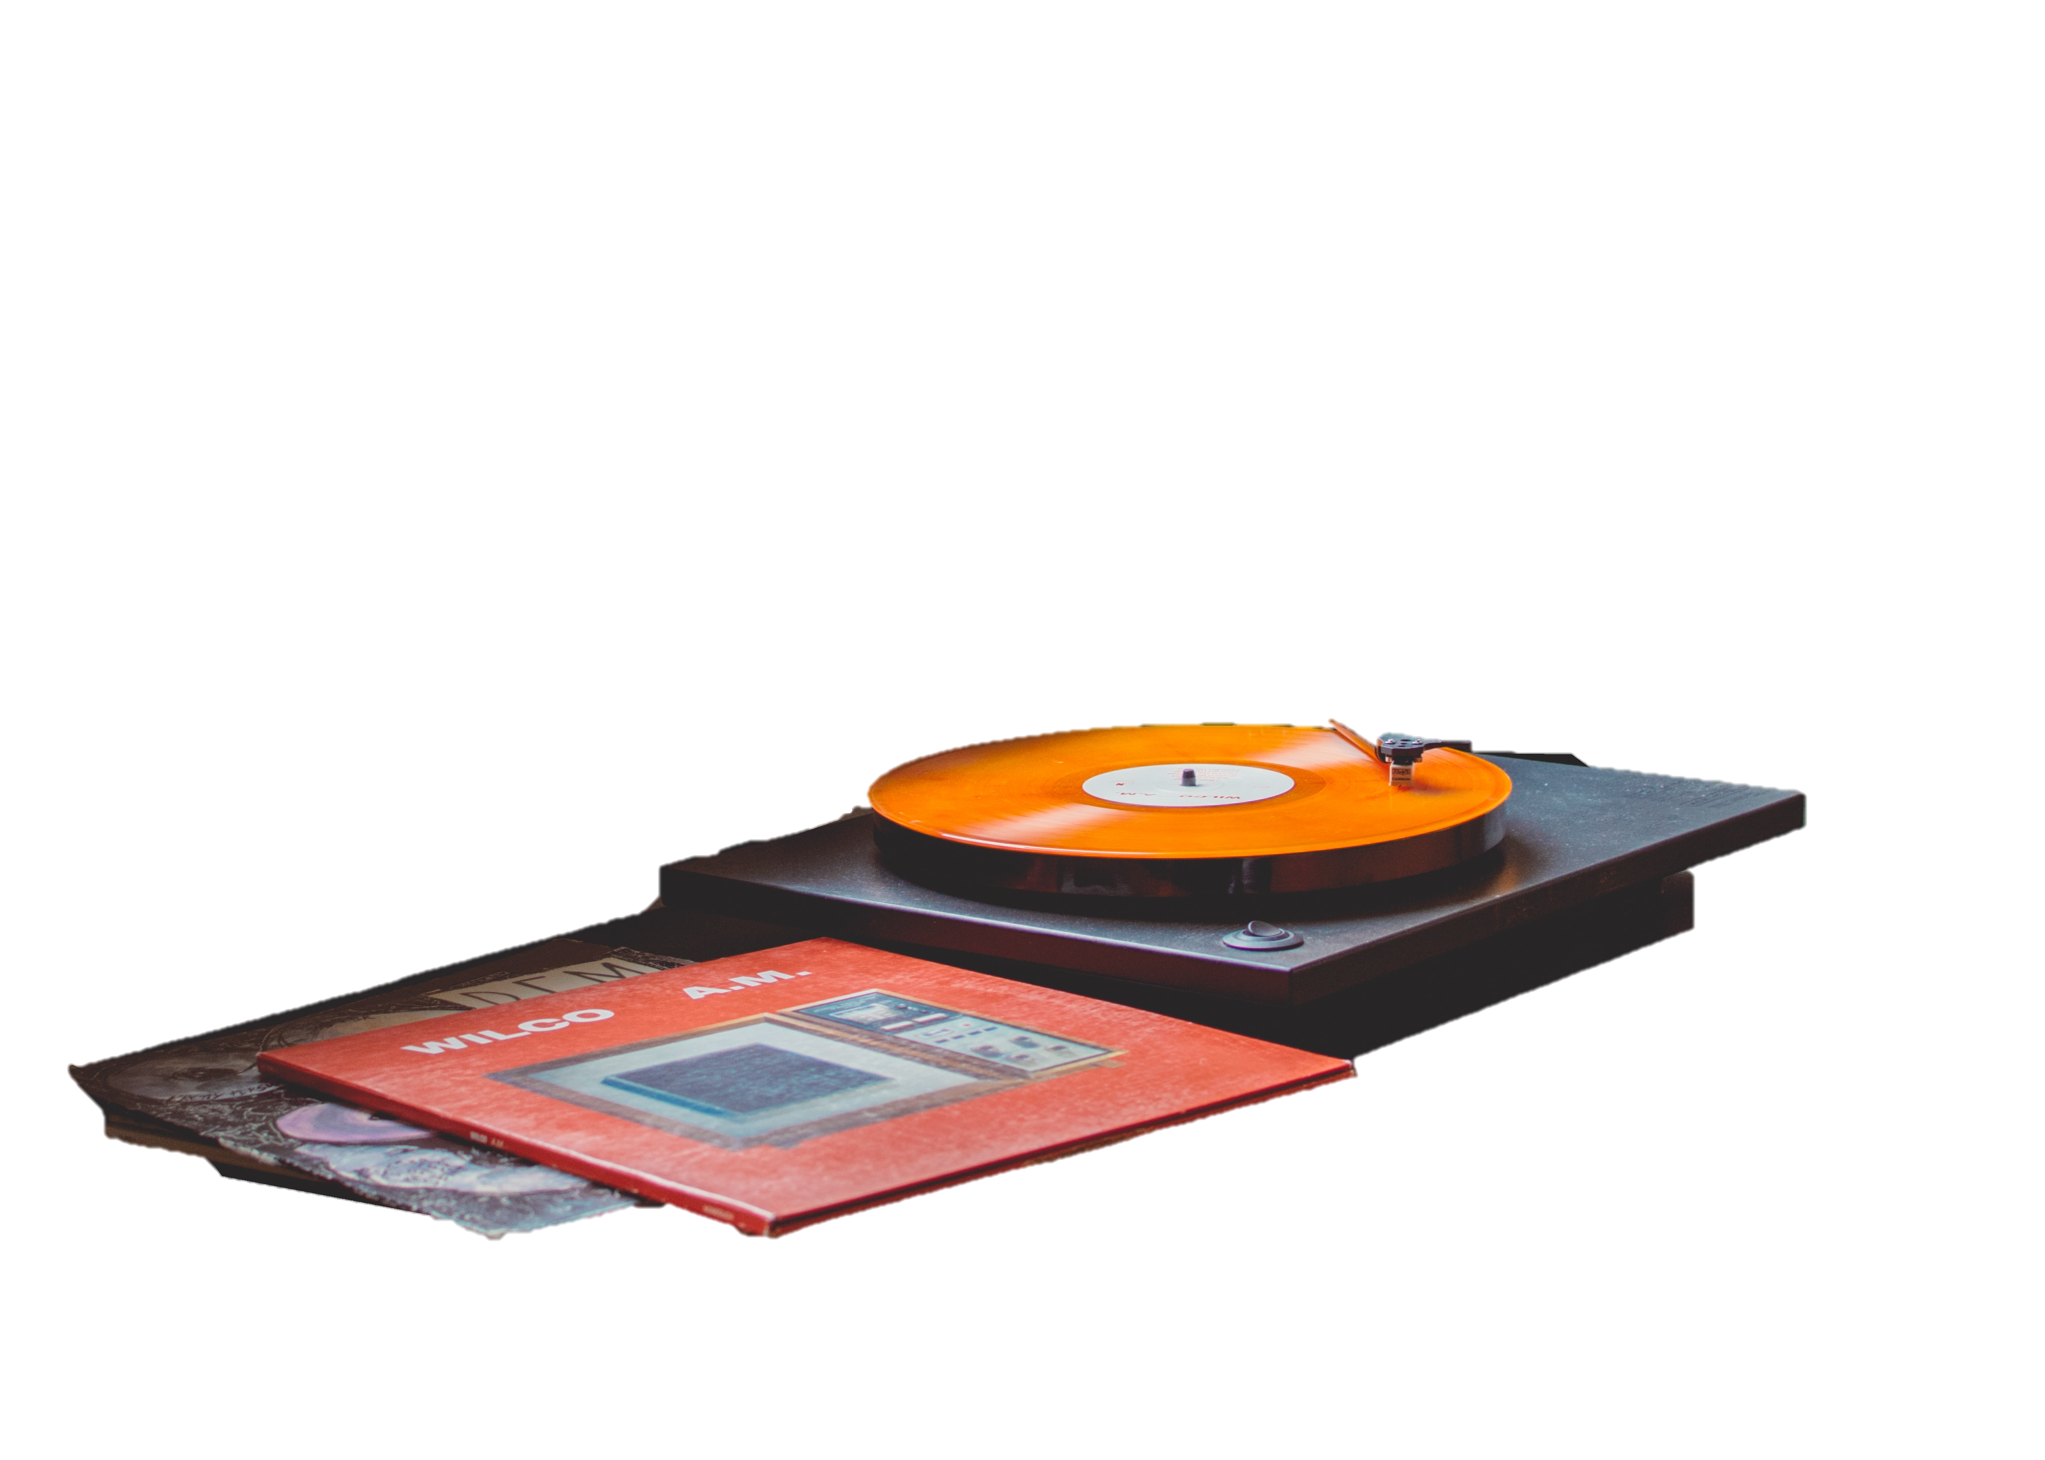
Statistical Methods.
A T-Test is used to determine whether the observed differences in our data are due to chance or if they are statistically significant.
Notes:
testing hypotheses is essential to make informed decisions and draw reliable conclusions based on evidence, ensuring that our beliefs and assumptions are supported by statistical analysis

Slide 6
Test 01.
Testing if there is a significant difference between above average quality homes and below average quality homes.
*
With P-value of approx. 0.00, investing in AAQ homes results in higher returns. With 95% confidence, the difference is between $8 to $10 more
$24 PER SQ FT.
$16 PER SQ FT.
Notes:
Homes are rated one through 10, 10 being the highest quality and one being the lowest quality
The results show that investing in above average quality homes is estimated to result in higher returns. I’m 95% confident that the difference is between eight to $10 more an above average quality homes
It begs the question: What are the top performing neighborhoods with AAQ homes?

Slide 7
Top Neighborhoods.
*
BY PRICE PER SQ FT
Below Average Quality Homes
Above Average Quality Homes
Notes:
As we can see the Blueste, Blmngtn, brdale, and Npkvill neighborhoods are blowing the other neighborhoods out of the water in terms of average price per sq ft. These top neighborhoods are doing about 90% better in average price per sq ft than the other neighborhoods. What happens if we just focus our efforts on the AAQ homes in these top neighborhoods?

Slide 8
Test 02.
Testing if there is a significance difference in the average price per square foot between the top neighborhoods and the other neighborhoods with above average quality homes.
*
With P-value of approx. 0.00, investing in AAQ homes in the top neighborhoods results in higher returns. With 95% confidence, the difference is between $30 to $40 more
$57 PER SQ FT.
$22 PER SQ FT.
Below Average Quality Homes
Above Average Quality Homes
Notes:
It goes without question, Investing in AAQ homes in the top neighborhoods is estimated to result in higher sale. With 95% confidence the CI is approx $30 - $40 more in average price per sq.

Slide 9
Test 03.
Testing if there is a significance difference in the price per square foot between above average quality 1 story and 2 homes in the top neighborhoods.
*
With P-value of approx. 0.00, investing in 2 story AAQ homes in the top neighborhoods results in higher returns. With 95% confidence, the difference is between $1 to $7 more
$31 PER SQ FT.
$27 PER SQ FT.
Below Average Quality Homes
Above Average Quality Homes
$31 PER SQ FT.
Notes:
Investing in 2 story AAQ homes in the top neighborhoods is estimated to result in higher sales. With 95% confidence the CI is approx. $1-$7 more in price per sq ft.

Slide 10

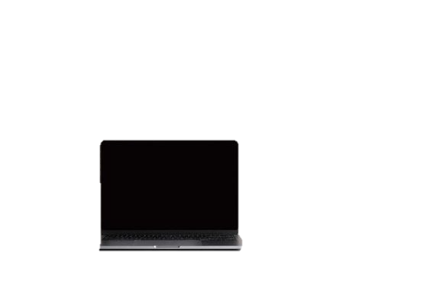
Recommendations.
Let’s focus our marketing on emphasizing the desirability and prestige, showcasing the superior quality, features, and leveraging the positive reputation and attractiveness of the neighborhoods.

Slide 11

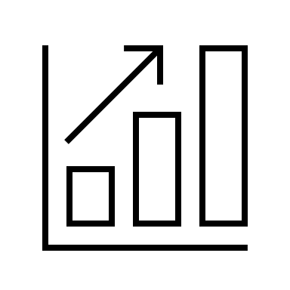

INVEST
TRACK
MARKET
INVEST
MARKET
TRACK
Analyze property quality, location, and home style searching for above average quality 2 story homes in these neighborhoods: Bluestem, Bloomington, brdale, and Npkvill
Create a marketing strategy to attract buyers
May Include: Online listing, social media campaign and networking with real estate agents or property managers.
Continuously monitor invested properties and the real estate market to stay informed about trends, changes in demand and pricing fluctuations
Notes:
To increase your chances of success and property investment, I recommend we focus on above average quality two-story homes located in the top neighborhoods, develop a robust marketing strategy to attract potential buyers, and diligently track both your invested properties in market trends. By implementing these recommendations, you can optimize your investment allocation and maximize returns in the competitive real estate market

Slide 12

Questions

